Slide 1

Introduction to Deep Learning Applications and Theory
Week 10
Lecture 28
AMATH 563

Slide 2
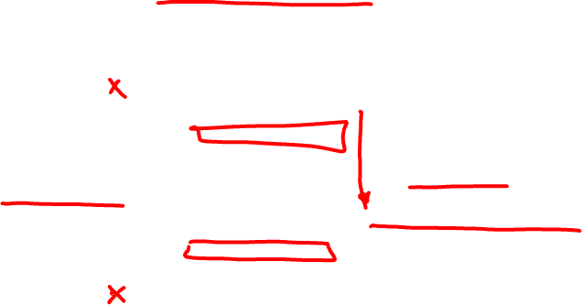
Latent States
Output
Manifold
Embedding
Latent
Dynamical System
Input

Slide 3
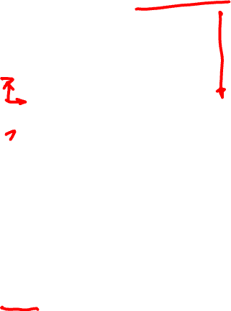
Interpret Seq2Seq
Encoder
Decoder
Inputs
Latent State
Outputs
Prediction/ Reconstruction Task (Loss)
Kun Su & Eli Shlizerman,
Clustering and Recognition of Spatiotemporal Features through Interpretable Embedding of Sequence to Sequence Recurrent Neural Networks, Frontiers in AI, 2020

Slide 4
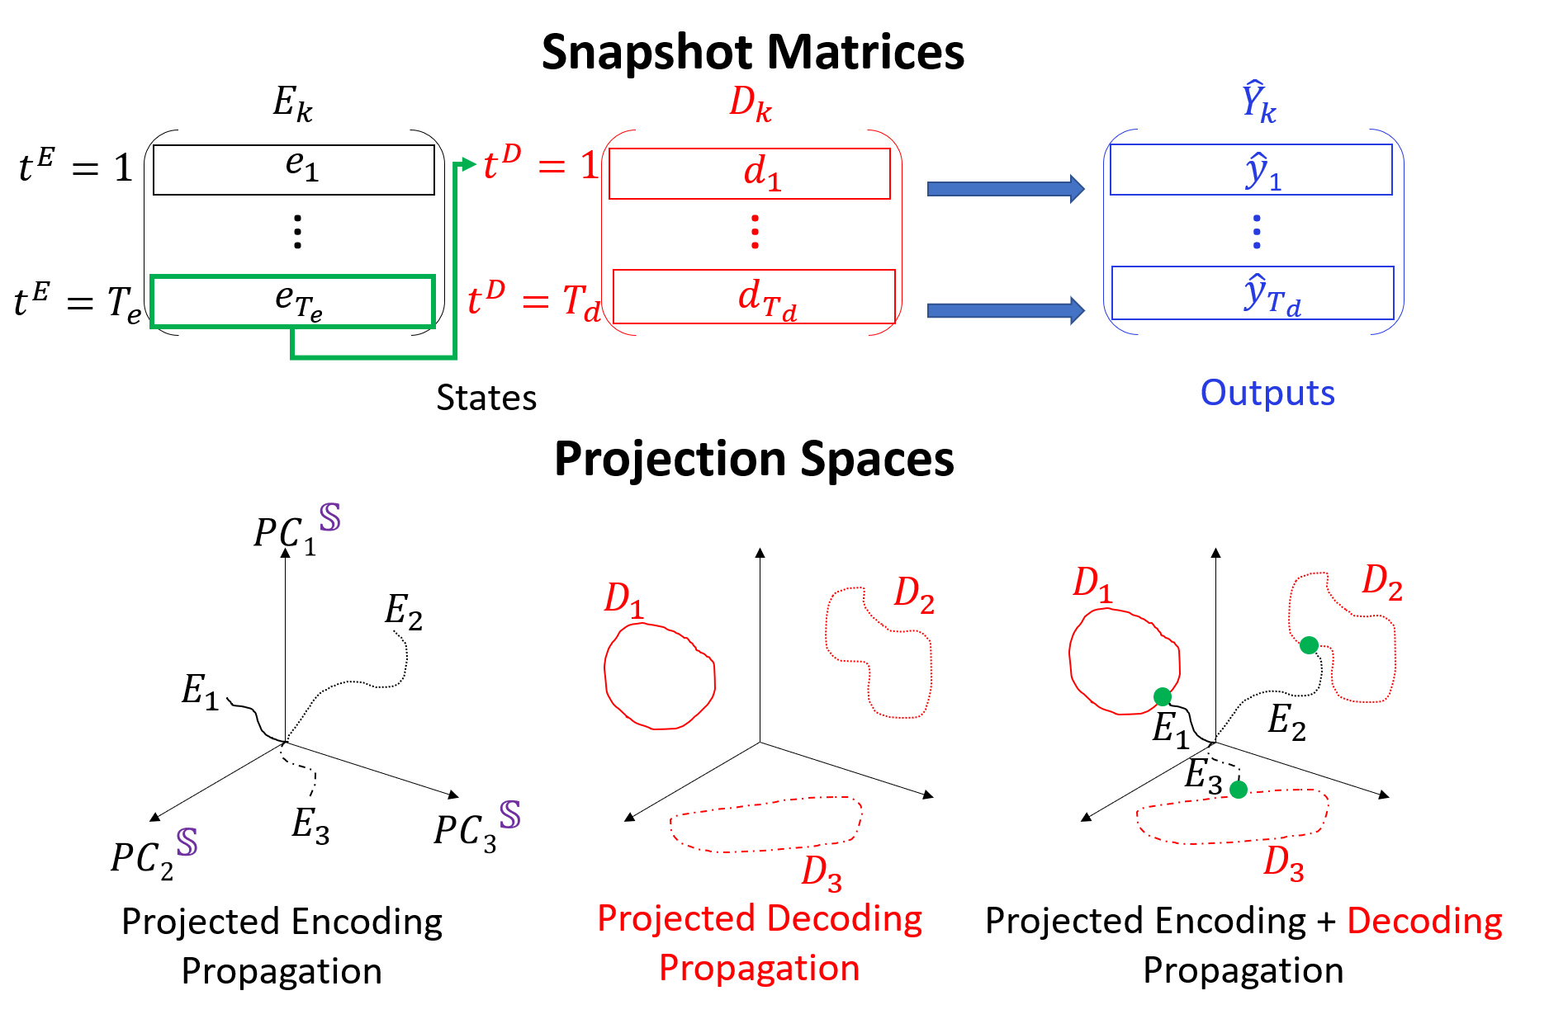
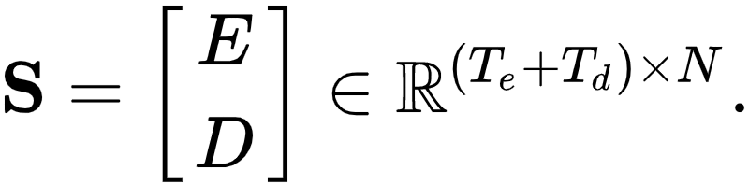
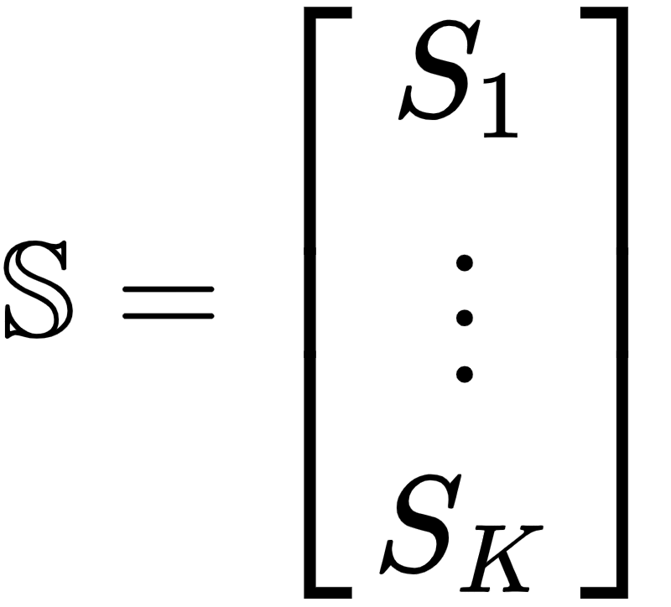
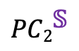
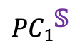
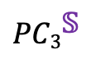

Embedding Spaces
Concatenate Encoder and Decoder States:
$${PC1}^{\text{𝕊}}$$
Concatenate K sequences:
Global state matrix:
SVD
$${PC3}^{\text{𝕊}}$$
$${PC2}^{\text{𝕊}}$$
E. Shlizerman, K. Schroder and J. N. Kutz,
Neural Activity Measures and Their Dynamics, SIAM Journal of Applied Mathematics, 2012.

Slide 5

Embedding Spaces
Start from Zero
Diverge from Each Other
Form Attractors
Prediction => Separation

Slide 6
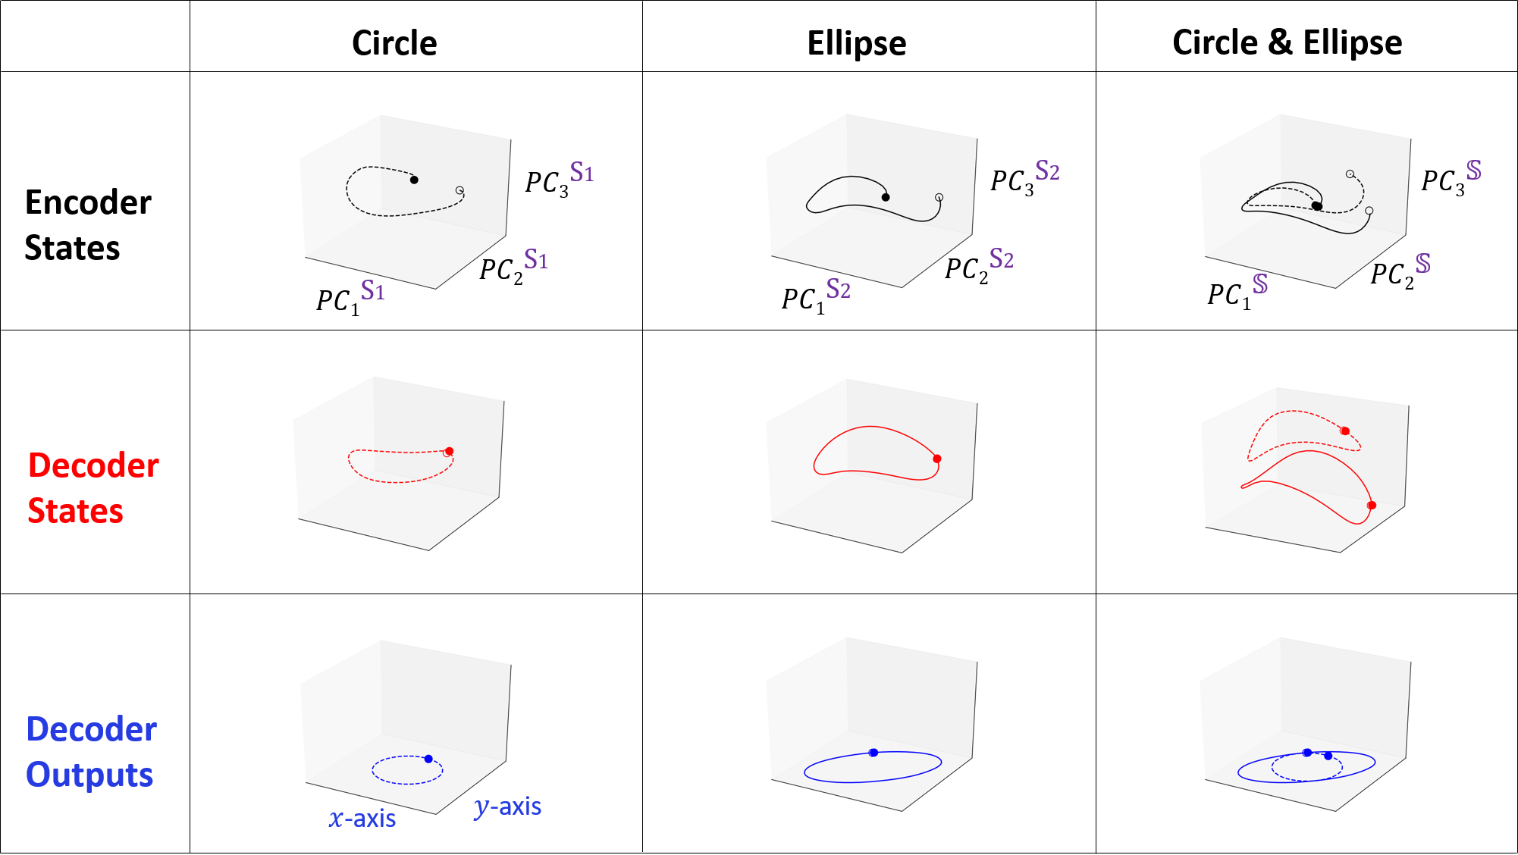
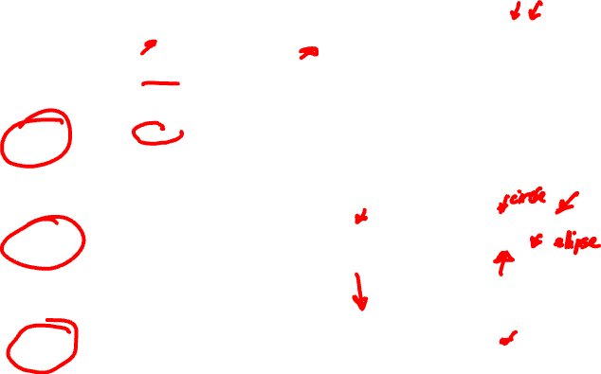
Embedding Toy Example
Input

Slide 7
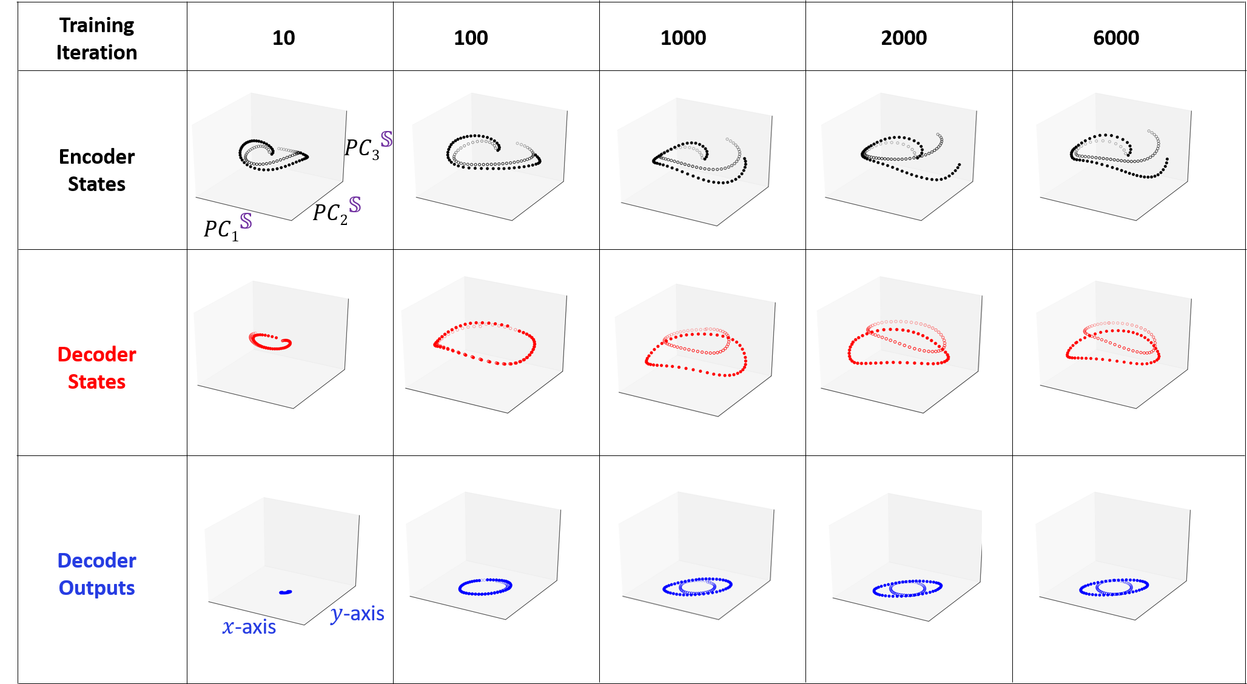

Clustering as an Outcome of Optimization

Slide 8
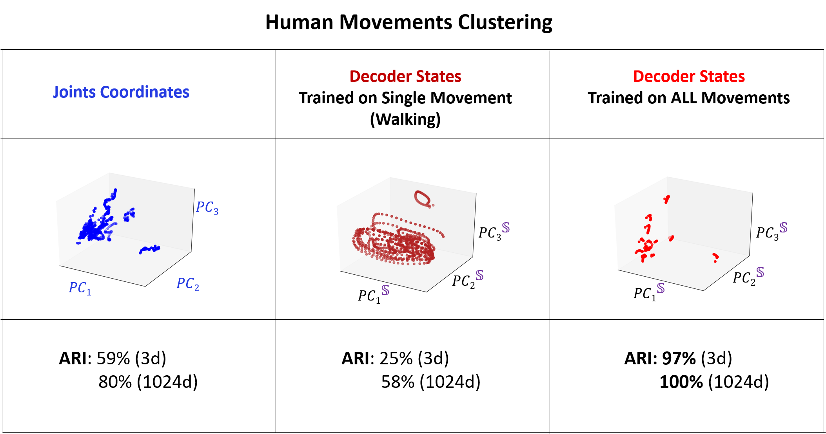
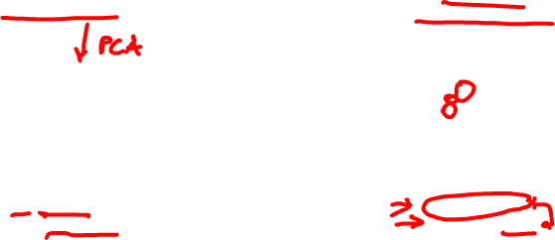
Clustering Human Movements

Slide 9
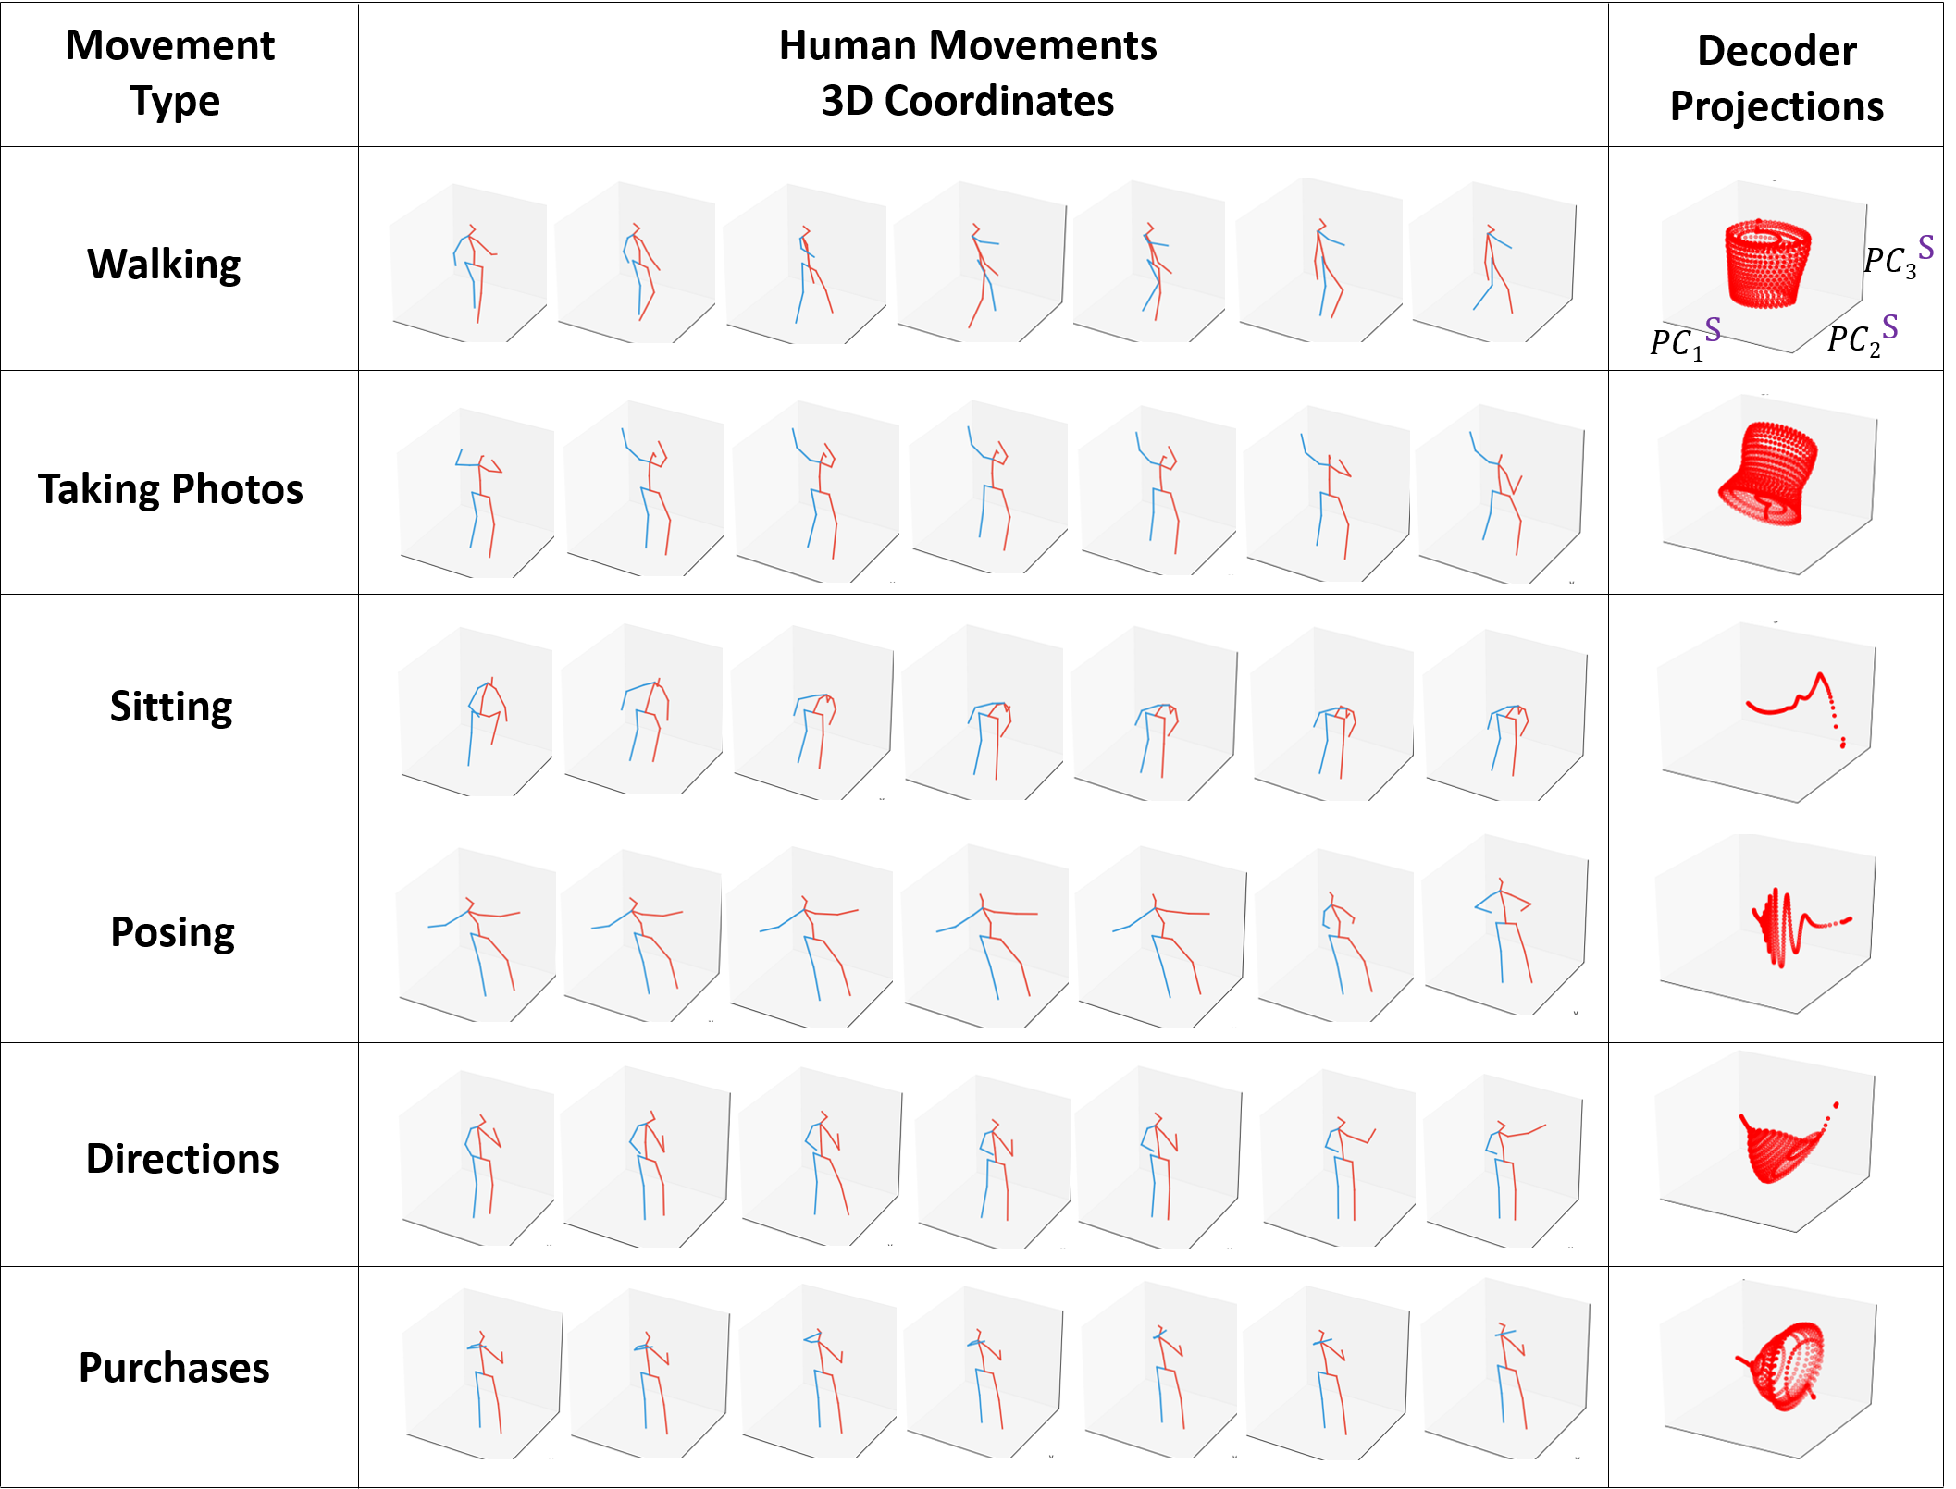
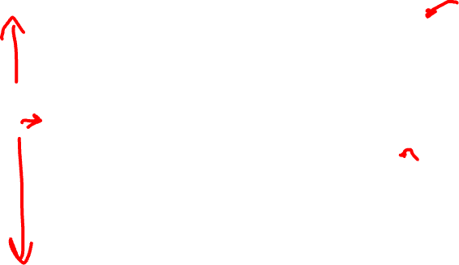
Embedded Body Dynamics Data

Slide 10
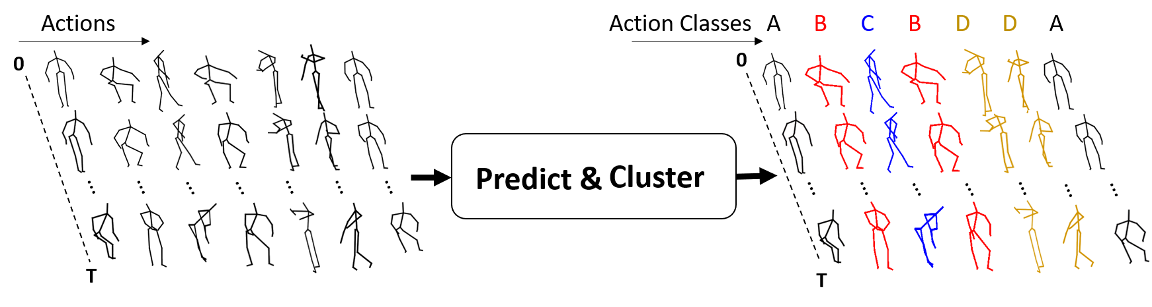
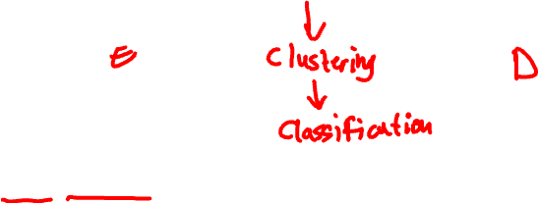
Action Recognition for Dynamic Data
Kun Su, Xiulong Liu & Eli Shlizerman,
Predict & Cluster: Unsupervised Skeleton Based Action Recognition, CVPR 2020

Slide 11
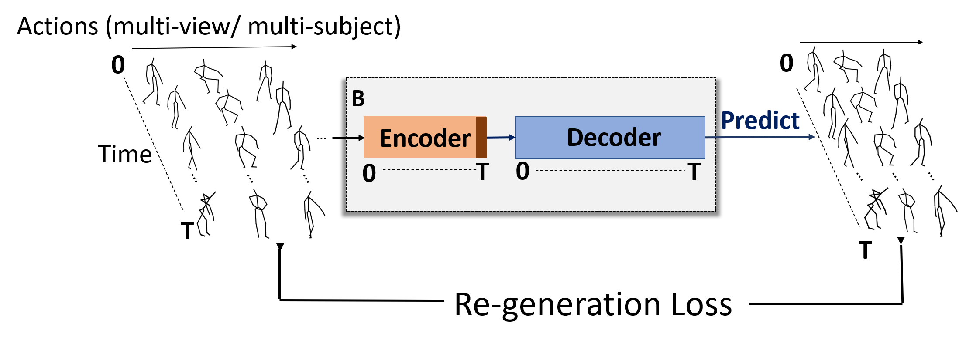


Action Recognition for Dynamic Data
Assign actions without labels?

Slide 12
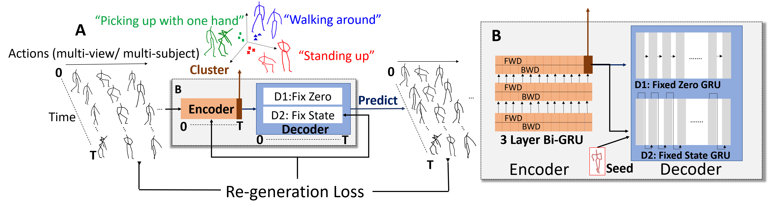
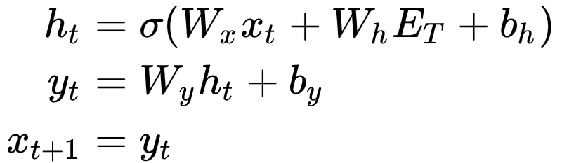

Weak Training
Fixed State: the decoder uses the last encoder state for all time steps.

Slide 13
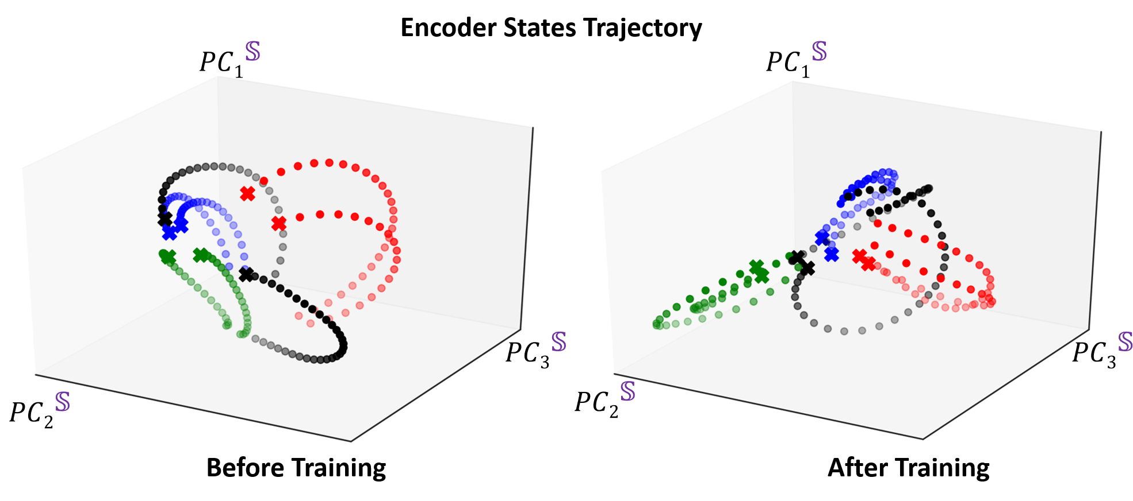

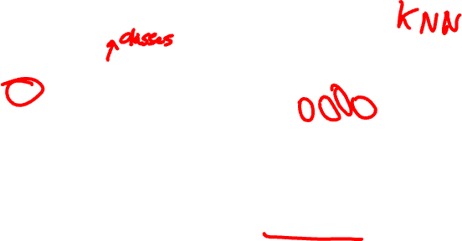
Weak Training Contraction in Embedding Space
Typical Embedding
“Weak Training” Embedding
disentanglement

